Slide 1


CHANG WAH TECHNOLOGY CO., LTD
(6548 TT)
Apr 11-13,2018

Slide 2

Disclaimer
This presentation has been prepared by CHANG WAH TECHNOLOGY CO., LTD.(the “Company”). This presentation and the materials provided herewith do not constitute an offer to sell or issue or the solicitation of an offer to buy or acquire securities of the Company in any jurisdiction or an inducement to enter into investment activity, nor may it or any part of it form the basis of or be relied on in connection with any contract or commitment whatsoever. Any decision to purchase securities in a proposed offering should be made solely on the basis of the information contained in the offering circular published in relation to such proposed offering, if any.
The information contained in this presentation has not been independently verified. No representation, warranty or undertaking, express or implied, is made as to, and no reliance should be placed on, the fairness, accuracy, completeness or correctness of the information or the opinions contained herein. The information contained in this document should be considered in the context of the circumstances prevailing at the time and has not been, and will not be, updated to reflect material developments which may occur after the date of the presentation. None of the Company nor any of its affiliates, advisors or representatives will be liable (in negligence or otherwise) for any loss howsoever arising from any use of this presentation or its contents or otherwise arising in connection with the presentation.

Slide 3

ON Semiconductor 2017 Supplier Award
CWTC wins the supplier excellence awards of ON Semiconductor 2017. (http://www.onsemi.com/PowerSolutions/newsItem.do?article=4056)
CWTC

Slide 4
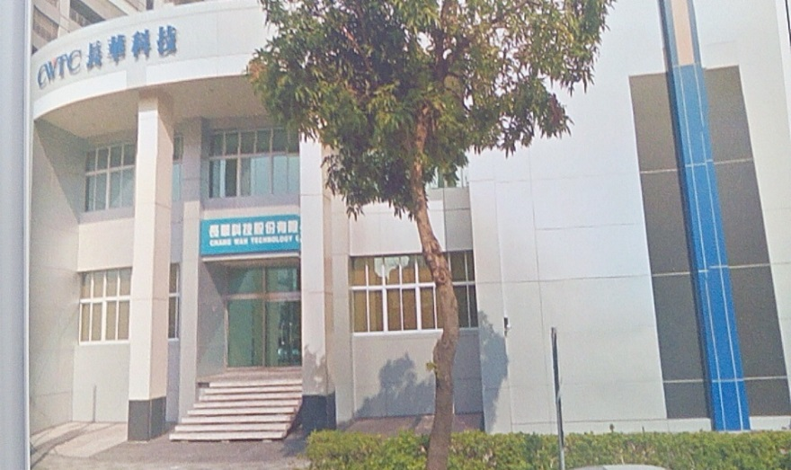
Outline
A. Company Introduction
B. Core Technology
C. Automotive Electronics and QFN Wettable Flank Packages
D. Financial Results
E. Development and Vision

Slide 5
A. Company Introduction

Slide 6
Company Information
Company Established | Dec. 24, 2009
President | Canon Huang
Capital | NTD 362 Million
Employees | 1,730(Consolidated)
Main Products | IC Metal Lead Frame Pre-Mold Metal Substrate
Subsidiary | SHAP (SH Asia Pacific Pte. Ltd.) 100%
Headquarters | Nan-Tze Export Processing Zone, Kaohsiung City ,Taiwan

Slide 7
Company History
2017/12 NT$ 50million capital increasing, the capital scale reached to 362 million.
2017/10 Purchased 49% OM (a lead frame factory in Japan) equity.
2017/06 Purchased other SHAP 40% equity from CWE and holds SHAP up to 100%.
2017/03 Purchased 60% SHAP and started to hold lead frame factory in China, Taiwan and
Malaysia.
2016/09 OTC stock trading.
2014/12 Increased NT$ 68million capital and the capital scale reached to 220 million.
2012/04 EMC product turned into mass production.
2012/01 EMC process technology developed.
2009/12 CWTC was established in with the set-up capital NT$ 10 million.

Slide 8
Investment Structure
CWE
(8070 TT)
45.42%
CWTC
(6548 TT)
100%
49%
100%
SHAP
(Singapore)
OM
(Japan)
CWTC-J (Japan)
100%
WSP
70%
70%
100%
100%
100%
SHEC
(Chengdu)
SHPC
(Chengdu)
SHS
(Suzhou)
MSHE
(Malaysia)
SHT
(Taiwan)
30%
30%

Slide 9
B. Core Technology

Slide 10
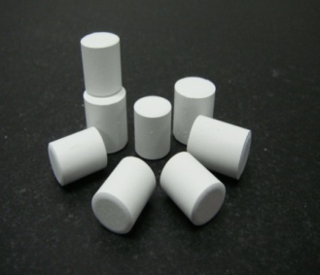

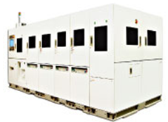
Pre-Mold Technology
Pre-Mold
Key Material
Mold Design
New process
(Post Plating)

Slide 11
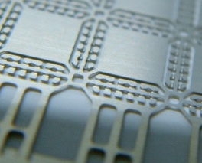
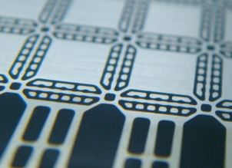
What is Pre-Mold
Structure
X-Section View
Conventional QFN L/F Unit
Metal(copper)
Dam Bar
Lead Pad
Die Pad
Lead Pad
Dam Bar
QFN Pre-Mold L/F Unit
EMC Filled

Slide 12
How is Pre-Mold
Features
No more yield loss
by mold flash!
No need of back side tape
No flash issue on back side when packing
Increase W/B UPH!
Good wire bondability
Solid support for wire bond process
FC Bonder /UPH ++
No more bump crack during handling!!!
Reliable Flip Chip bondability
Solid support for solder joint in F/C application

Slide 13
Pre-Mold Lead Frame Advantage
Process Simplification
Conventional LF Packing Process
LF
D/BW/B
Back side Taping
Molding
Tape Removing
De-flashing
Back side Plating
Singulation
Pre-Mold LF Packing Process (Remove plating process in Customer side )
PMLF
Ni/Pd/Au Post Plated
D/B
W/B
Molding
Singulation
Reduce Process,
Minimize Yield Loss
No Wasted Water/Chemical Treatment
Notes:
To reduce PKG total stand off height, reduce LF thickness is KEY.
Thinner LF OSATs cannot handle in assembly process…….with pre-mold make it possible!

Slide 14
Customized Process
Copper plate
1st Etching
1st molding
Plating
Process Simplification
Copper plate
1st Etching
1st molding
2nd Etching
Plating
Wettable Frank QFN (for Automotive)
Copper plate
1st Etching
1st molding
2nd Etching
2nd molding
Plating
500 I/O (QFN Size 15mm*15mm)

Slide 15
C. Automotive Electronics and QFN Wettable Flank Packages

Slide 16
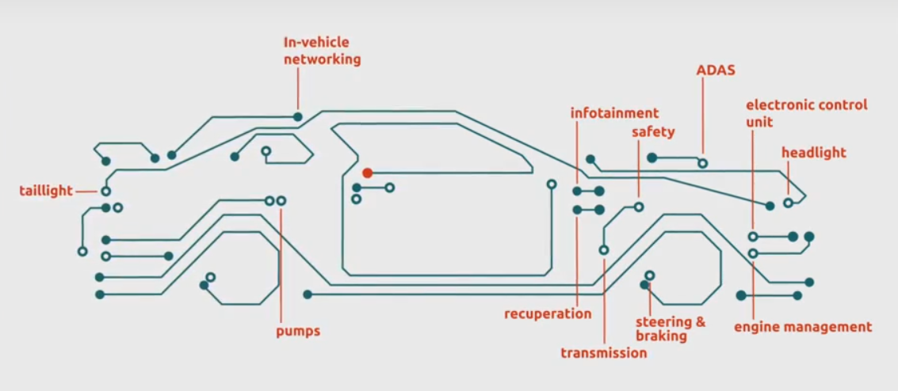
Automotive Electronics and QFN Wettable Flank
Packages
Automotive ICs included Microcontrollers (MCU), Application Specific Standard Products (ASSP)/Application-Specific Integrated Circuits (ASIC), Analog, Power Transistors, Sensors, etc.
Annual automotive semiconductor market exceeds $30 billion.

Slide 17
Automotive IC Features
The electronic components for automotive requires high reliability to the weather condition, especially the requirement for high temperature resistance is higher than performance and power consumption.
In addition to the high temperature environment, electronic components will also face adverse conditions such as crash and sudden environmental change, so the package design must use relatively stable pin design and solder surface connection method to strengthen the stability of the component on the PCB.
In order to ensure effective soldering of the solder joints, the requirements for automotive electronics on the lead frame are "must be visually observed or automated optical inspection" to determine whether it is an effective solder.

Slide 18
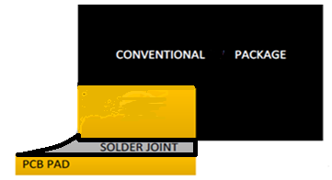
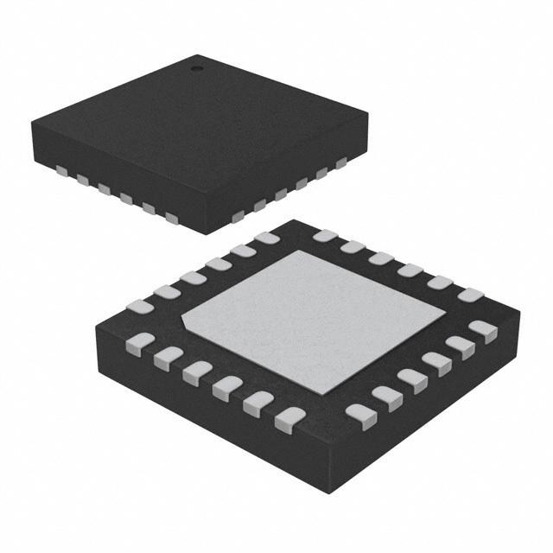
QFN(Quad Flat No Lead)
QFN has a small size and is similar to a Chip Scale Package (CSP) package type. It is relatively inexpensive and has a feature of reducing thermal resistance. It is because that it does not require leads extend from four sides, it has excellent electrical performance and is very suitable for use in low-speed/high-speed/high-frequency system products.
SMT characteristics: QFN uses the bottom terminal of the package as soldering area, it is generally difficult to judge whether the solderability is good from the solder point of its appearance. Even though the QFN terminal still exposed on side wall, but because there no tin plating on side wall, it is difficult to get wetting in reflow process.

Slide 19
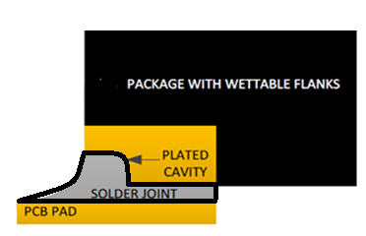
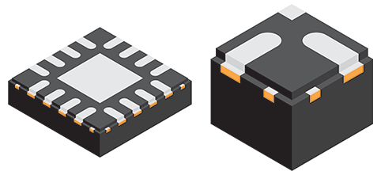
Wettable Flank
Wettable Flank is used to improve the QFN package soldering features and its reliability. The most important is that the manufacturing process can be reduced by simplifying the manufacturing process through post-soldering optical inspection.
Wettable Flank significantly improves the QFN soldering quality and meets the requirements of automotive electronics - visually observing the quality of soldering, making it ideal for a variety of automotive electronic system applications.

Slide 20
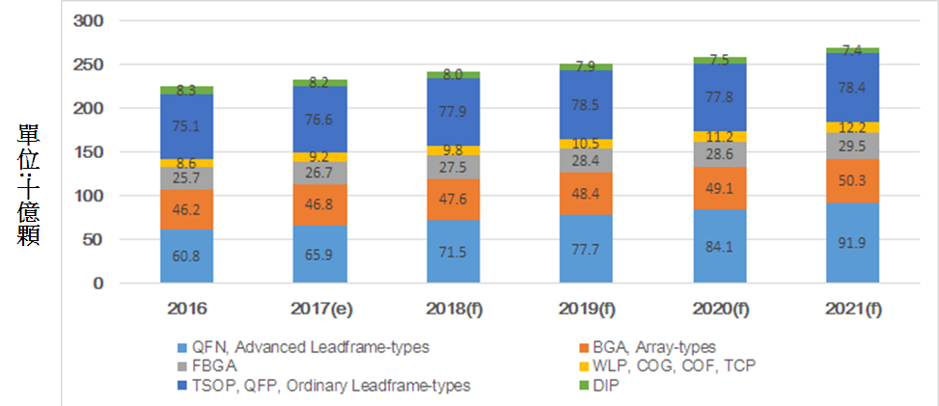
QFN Growth Trend
In 2016, lead frame packaged ICs accounted for about 64.2% of the total IC package.
The share of high-order lead frames (mainly QFNs) in the total package size will increase from 27.1% (in 2016) to 32.1% (in 2021).

Slide 21
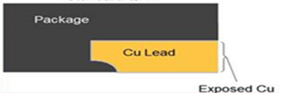
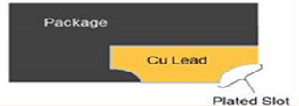
Advantages of CWTC's Wettable Flank Process
CWTC uses Pre-Mold skill to etch the standard QFN substrate → Molding → 2nd etching → plating.
In 2nd etching, we etch the wettable side stages directly, reducing the 50% cutting process of the OSATs in the Wettable Flank package. Achieving better production yields and cost reduction.

Slide 22
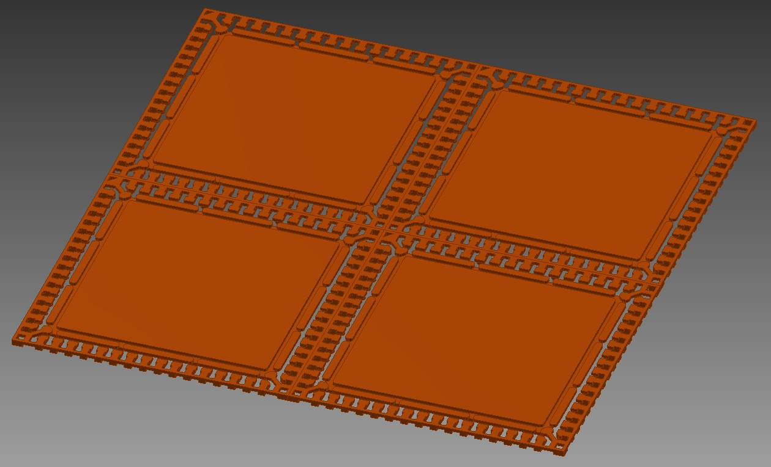
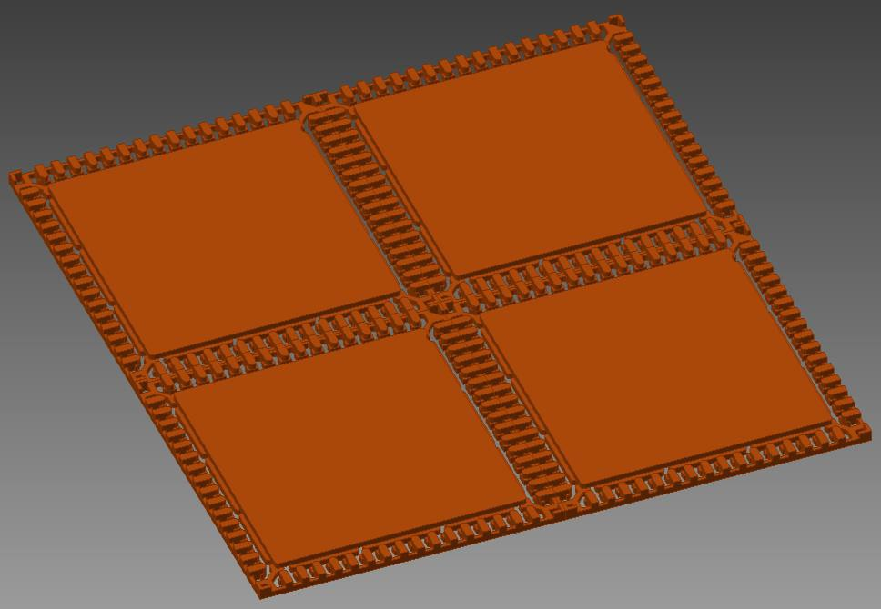
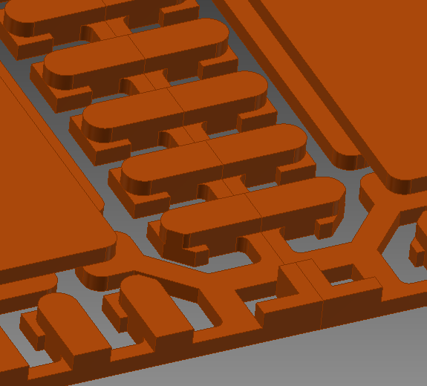
Etching Lead Frame (show 2x2 unit)
Top side view
Back side view

Slide 23
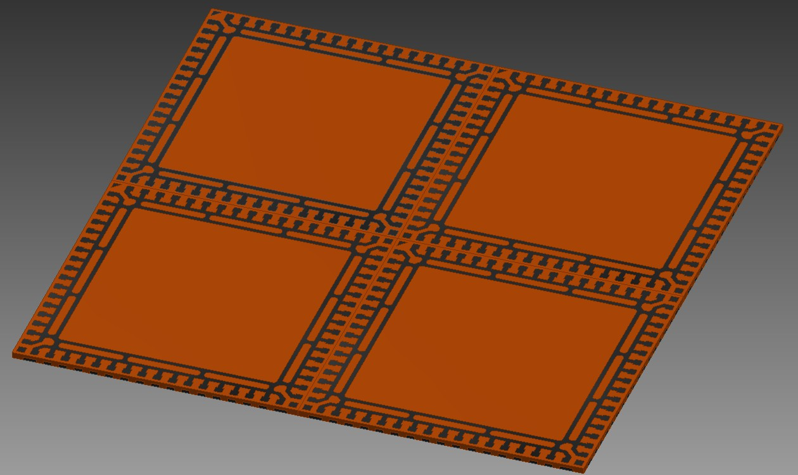
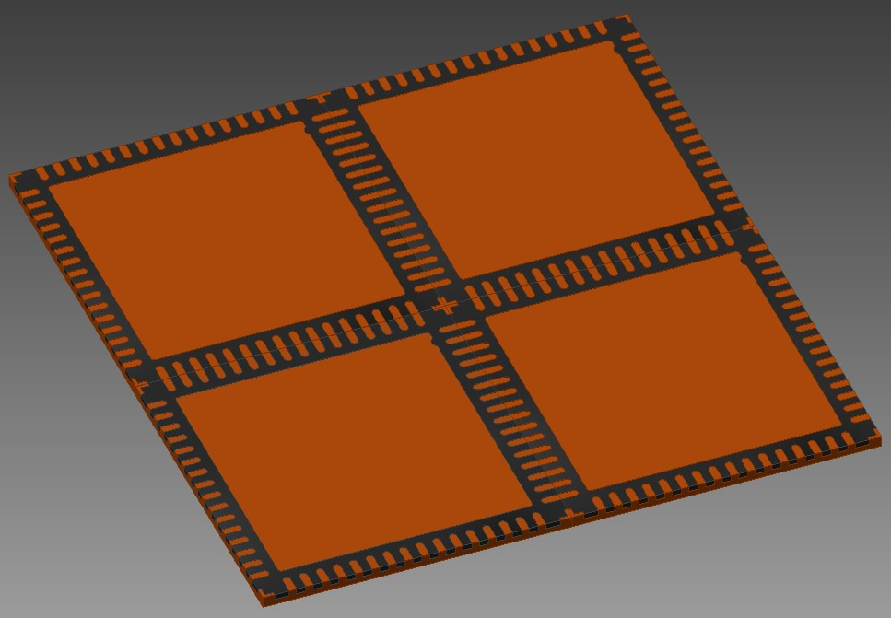
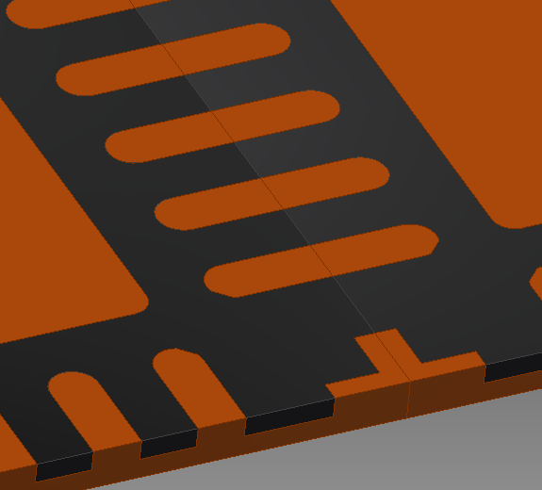
Molding (show 2x2 unit)
Top side view
Back side view

Slide 24
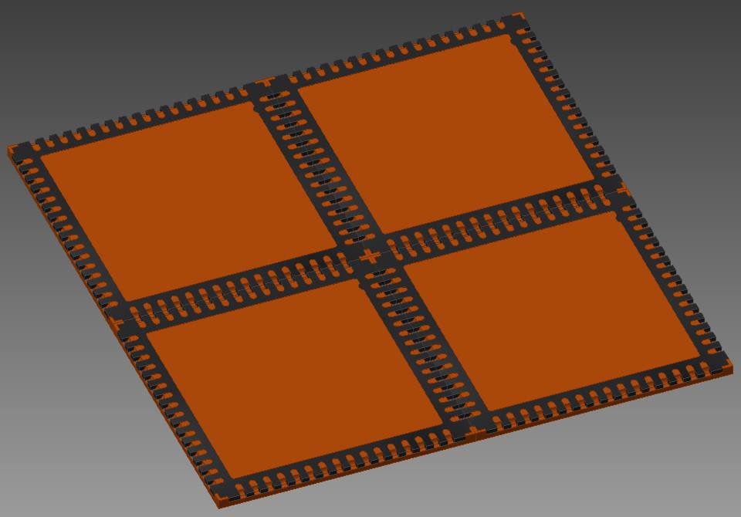
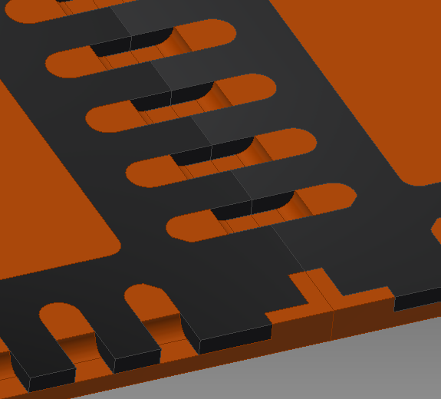
2nd Etching(show 2x2 unit)
Top side view
Back side view

Slide 25
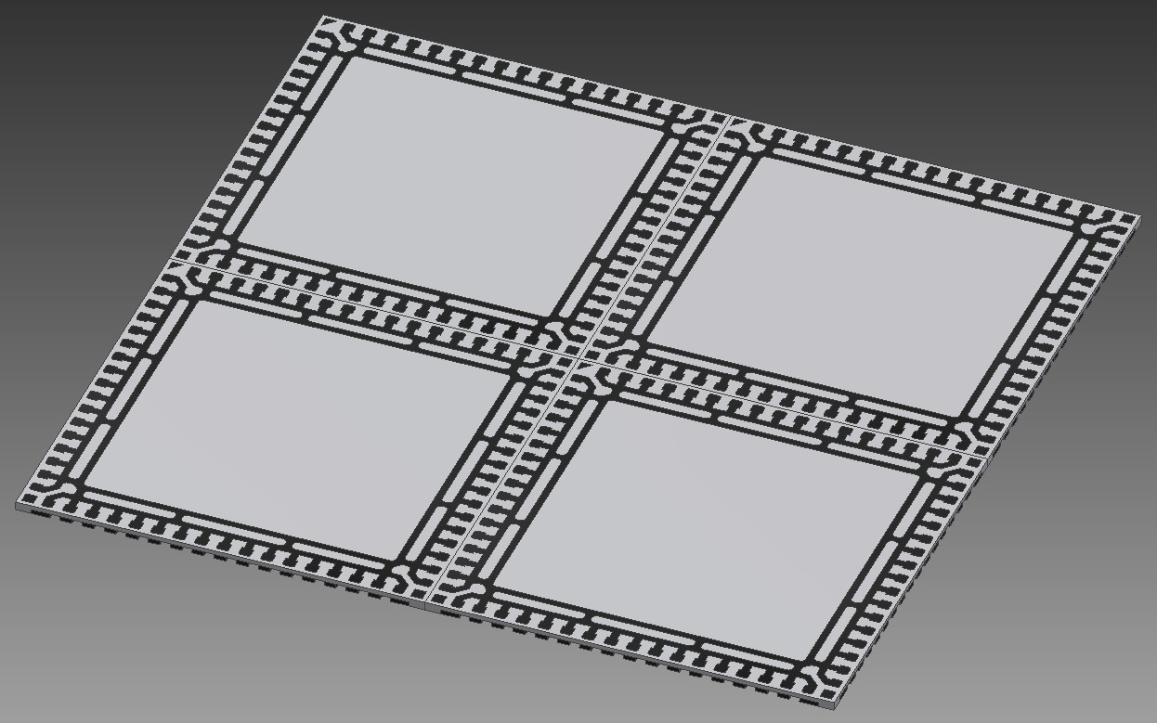
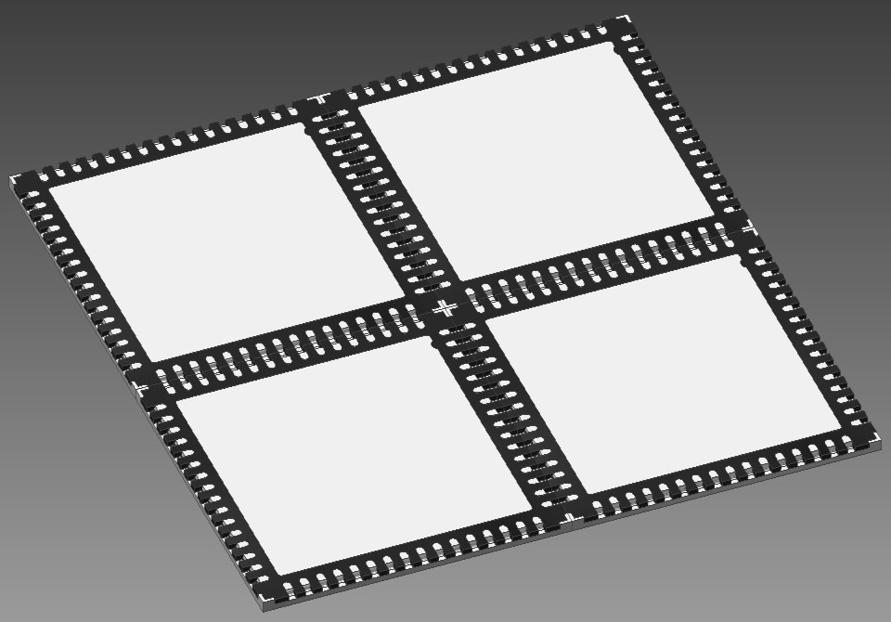
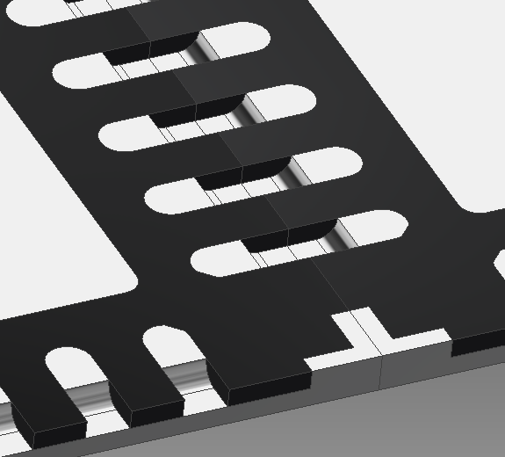
Plating (show 2x2 unit)
Top side view
Back side view

Slide 26
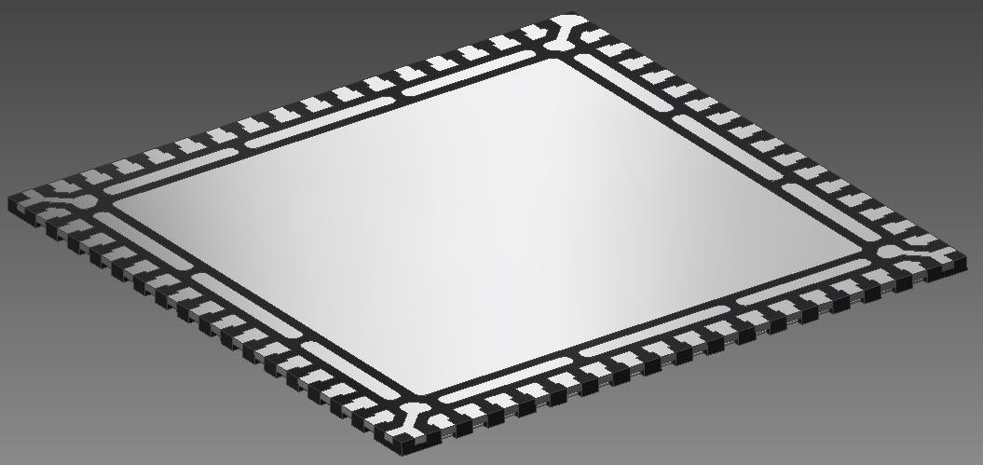
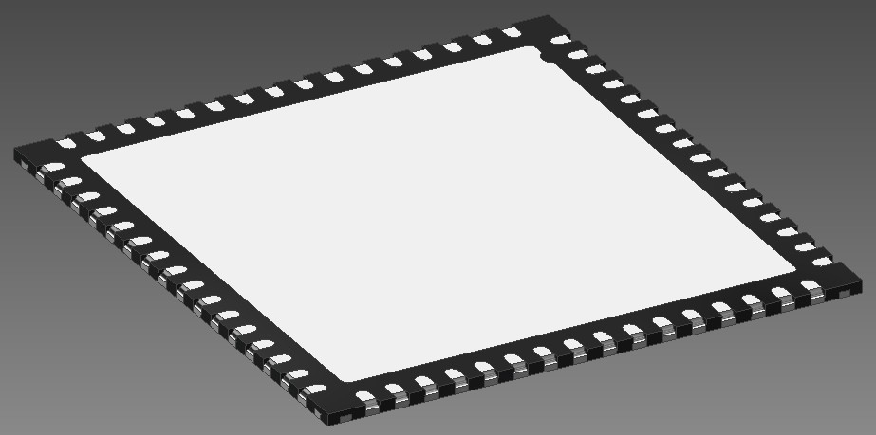
Sawing Show (Unit)
A
A
Top side view
Back side view
A-A Section

Slide 27
D. Financial Results

Slide 28
Financial Results
(Consolidated Monthly Revenue Trend)
NTD,000

Slide 29
Financial Results(Consolidated Income Statement)

Slide 30
Financial Results(Consolidated Income Statement)

Slide 31
Consolidated Balance Sheet Summary

Slide 32
Products Percentage – 1 (Application)
*Classified by sales amount (US$)
IC：SOP、TSSOP、TSOP、QFP
Discrete：SOT

Slide 33
Products Percentage – 2 (Process)
*Classified by sales amount (US$)

Slide 34
E. Development

Slide 35
Development and Growth Engine
Expand QFN Capacity
Popularize Pre-Mold Technology and Develop Wettable Flank QFN
Catch New Business in Etching Components for Other Applications
M&A Opportunity

Slide 36
Q & A

