Slide 1
長華科技股份有限公司
(6548)
2018/4/11

Slide 2
Disclaimer
This presentation has been prepared by CHANG WAH TECHNOLOGY CO., LTD.(the “Company”). This presentation and the materials provided herewith do not constitute an offer to sell or issue or the solicitation of an offer to buy or acquire securities of the Company in any jurisdiction or an inducement to enter into investment activity, nor may it or any part of it form the basis of or be relied on in connection with any contract or commitment whatsoever. Any decision to purchase securities in a proposed offering should be made solely on the basis of the information contained in the offering circular published in relation to such proposed offering, if any.
The information contained in this presentation has not been independently verified. No representation, warranty or undertaking, express or implied, is made as to, and no reliance should be placed on, the fairness, accuracy, completeness or correctness of the information or the opinions contained herein. The information contained in this document should be considered in the context of the circumstances prevailing at the time and has not been, and will not be, updated to reflect material developments which may occur after the date of the presentation. None of the Company nor any of its affiliates, advisors or representatives will be liable (in negligence or otherwise) for any loss howsoever arising from any use of this presentation or its contents or otherwise arising in connection with the presentation.

Slide 3


ON Semiconductor 2017 供應商獎
CWTC wins the supplier excellence awards of ON Semiconductor 2017. (http://www.onsemi.com/PowerSolutions/newsItem.do?article=4056)
CWTC

Slide 4
大綱
公司簡介
核心技術
車用電子與QFN Wettable Flank封裝
營運績效
未來展望

Slide 5
A.公司簡介

Slide 6
公司基本資料
設立日期 | 2009年12月24日
董事長 | 黃嘉能
實收資本額 | 新台幣3.62億元
員工人數 | 1,730人(合併)
主要產品 | IC Metal Lead Frame、 Pre-Mold Metal Substrate
主要轉投資 | SHAP 100%
總公司/工廠 | 高雄市楠梓加工出口區

Slide 7
公司沿革
2017/12 辦理現金增資5,000千股，資本額3.62億元
2017/10 買下WSP 100%股權以及日本OM廠49%股權
2017/06 再次買下SHAP 40%股權，累計持有SHAP 100%股權
2017/03 買下SHAP 60%股權
2016/09 股票上櫃交易
2014/12 現金增資6,800千股，資本額2.2億
2012/04 EMC產品正式導入量產，並擴增EMC產線自動化設備
2012/01 環氧封膠樹酯(EMC)製程技術開發成功
2009/12 公司設立，從事LED導線架之生產、銷售，資本額1千萬

Slide 8
主要轉投資架構
CWE
(8070)
45.42%
CWTC
(6548)
100%
49%
100%
SHAP
(Singapore)
OM
(Japan)
CWTC-J (Japan)
100%
WSP
70%
70%
100%
100%
100%
SHEC
(成都)
SHPC
(成都)
SHS
(蘇州)
MSHE
(馬來西亞)
SHT
(台灣)
30%
30%

Slide 9
B.核心技術

Slide 10
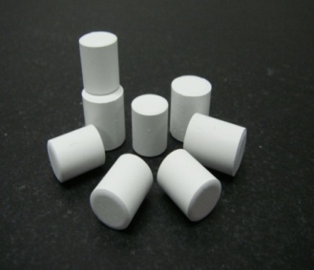
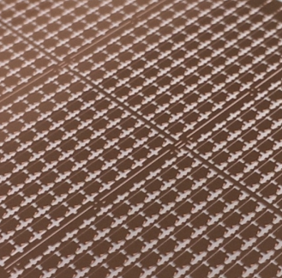
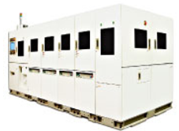
Pre-Mold技術
Pre-mold
關鍵
材料
模具
設計
新製程
(Post Plating)

Slide 11
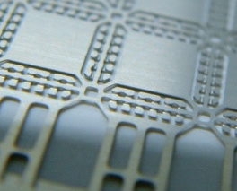
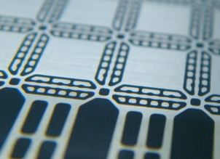
What is Pre-Mold
Structure
X-Section View
Conventional QFN L/F Unit
Metal(copper)
Dam Bar
Lead Pad
Die Pad
Lead Pad
Dam Bar
QFN Pre-Mold L/F Unit
EMC Filled

Slide 12
How is Pre-Mold
Features
No more yield loss
by mold flash!
No need of back side tape
No flash issue on back side when packing
Increase W/B UPH!
Good wire bondability
Solid support for wire bond process
FC Bonder /UPH ++
No more bump crack during handling!!!
Reliable Flip Chip bondability
Solid support for solder joint in F/C application

Slide 13
Pre-Mold Lead Frame Advantage
Process Simplification
Conventional LF Packing Process
LF
D/BW/B
Back side Taping
Molding
Tape Removing
De-flashing
Back side Plating
Singulation
Pre-Mold LF Packing Process (Remove plating process in Customer side )
PMLF
Ni/Pd/Au Post Plated
D/B
W/B
Molding
Singulation
No Wasted water/chemical treatment
Reduce Process,
Minimize Yield Loss
Notes:
To reduce PKG total stand off height, reduce LF thickness is KEY.
Thinner LF OSATs cannot handle in assembly process…….with pre-mold make it possible!

Slide 14
客製化製程
Copper plate
1st Etching
1st molding
Plating
Process Simplification
Copper plate
1st Etching
1st molding
2nd Etching
Plating
Wettable Frank QFN
Copper plate
1st Etching
1st molding
2nd Etching
2nd molding
Plating
500 I/O (15mm*15mm)
是否做2nd Molding視製程需求

Slide 15
C. 車用電子
與QFN Wettable Flank封裝

Slide 16
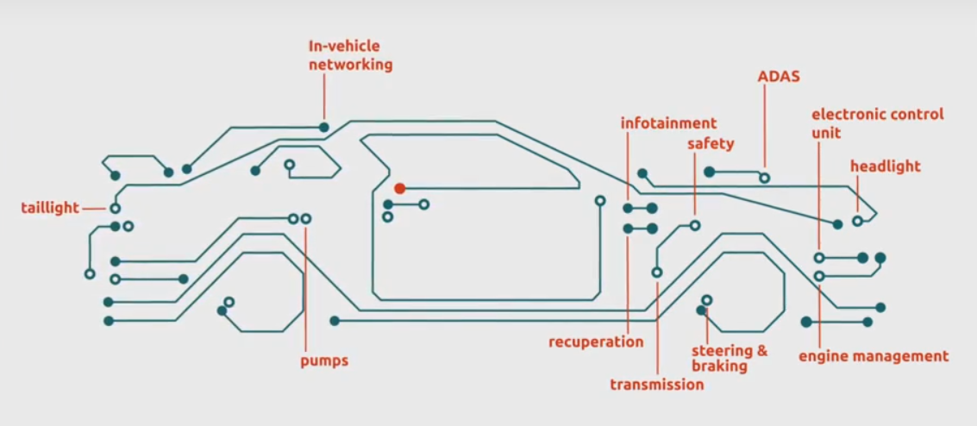
車用電子與QFN Wettable Flank封裝
車用IC大致上可分為微控制器(MCU)、特定應用標準產品(ASSP)/特定應用積體電路(ASIC)、類比(Analog)、功率電晶體(Transistor)、感測器(Sensor)等。(車用半導體年產值逾300億美元)

Slide 17
車用電子特性
車用電子特別要求電子元件的抗候能力，尤其是抗高溫的需求通常會優先於性能與功耗的要求。
除了高溫環境外，電子元件還會面臨衝擊與環境震動等惡劣情況，故封裝設計必須利用相對穩固的引腳設計與焊接面，來強化元件在PCB上的穩固程度。
為確保焊接點有效焊接，車用電子對導線架的要求為「必須以視覺觀察或自動化光學檢測」來確定是否為有效焊接。

Slide 18
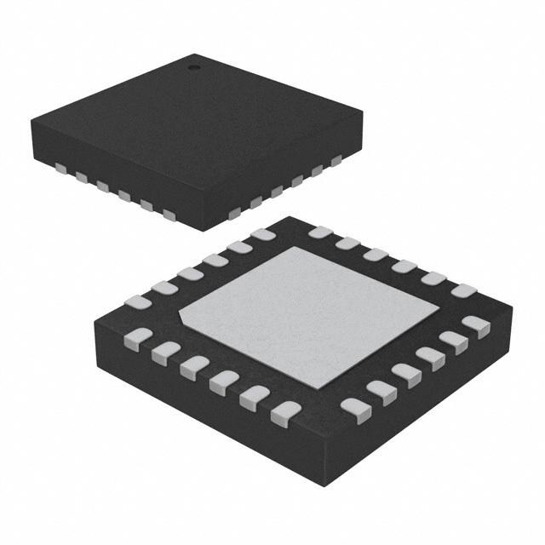
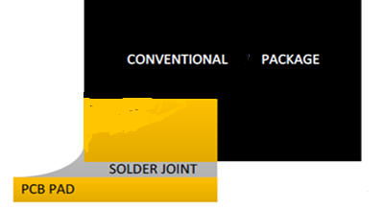
QFN(四邊扁平無接腳(Quad Flat No Lead))
QFN體積小，類似CSP(Chip Scale Package)封裝型態，且成本相對便宜，並具有降低熱阻的特性，又因為不需要從四邊引出接腳，所以電性效能極佳，非常適用於中、低腳數的高發熱、高速/高頻系統產品。
焊接特性：QFN採用封裝底面端子作為焊接點，一般很難從其外觀的焊錫點來判斷其焊錫性是否良好，即便 QFN側面仍留有焊腳，但有些只是橫切面並未電鍍，吃錫不易。

Slide 19
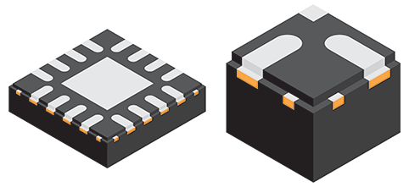
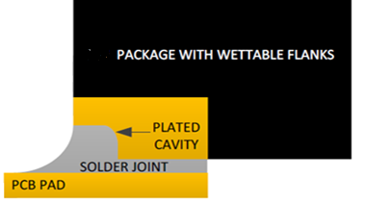
Wettable Flank
Wettable Flank又稱為可潤濕側翼，用於改進QFN封裝焊接特性，提高可靠性，最更重要的是，透過焊後光學檢測簡化製造過程，直接降低檢測成本。
Wettable Flank大幅提高QFN焊接品質，可符合車用電子的要求 ─ 以目視觀察焊接品質，非常適用於各種汽車電子系統應用。

Slide 20
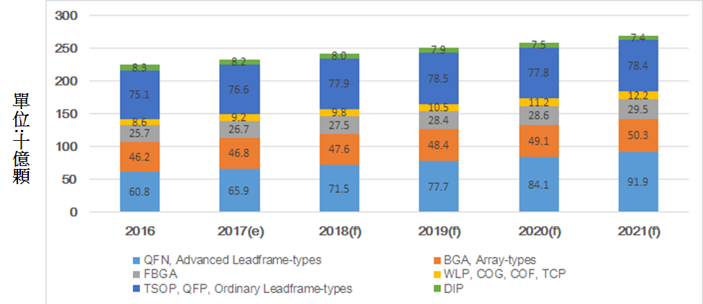
QFN成長趨勢
2016年使用導線架封裝的IC約佔整體IC封裝的64.2%。
高階導線架(以QFN為主)所佔整體封裝顆數比重將由2016年的27.1%上升至2021年的32.1%。

Slide 21
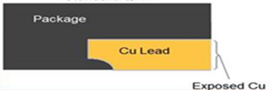
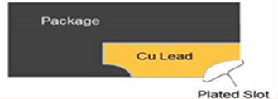
CWTC投入Wettable Flank製程優勢
長華科利用Pre-Mold技術，將經過一次蝕刻的標準QFN基板進行Molding→再做第二次蝕刻→最後電鍍。
也就是直接以第二次蝕刻去刻出台階，形成可潤濕側翼，取代掉封裝廠在Wettable Flank封裝時的額外一倍的切割工序，大幅提高良率、降低成本。

Slide 22
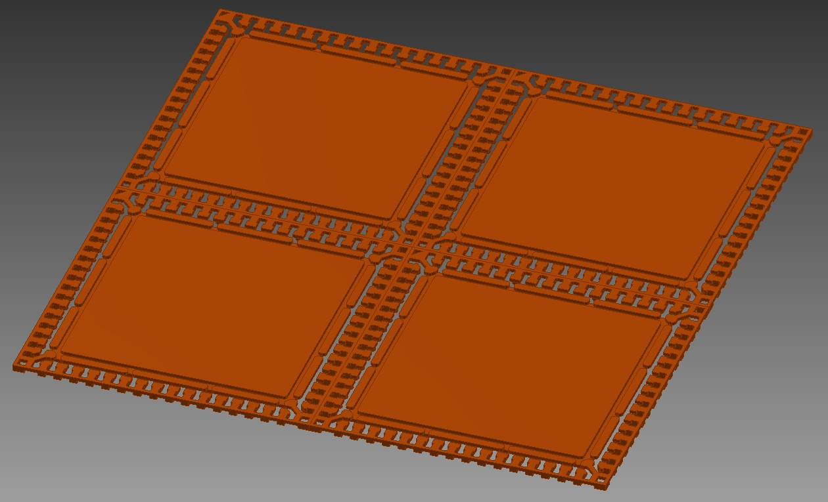
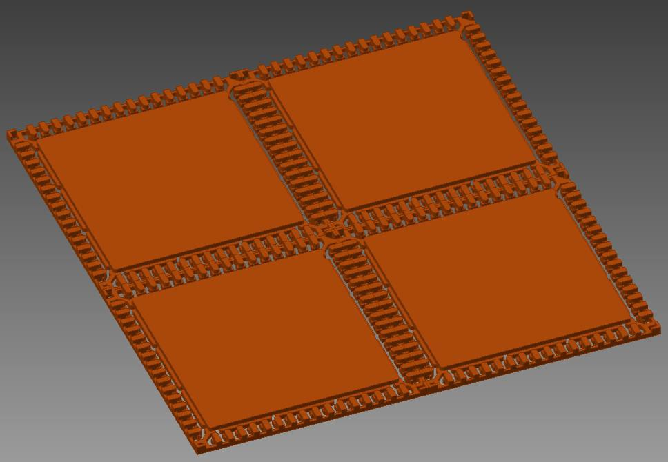
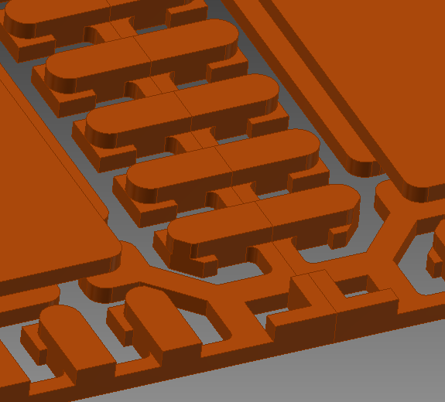
Etching Lead Frame (show 2x2 unit)
Top side view
Back side view

Slide 23
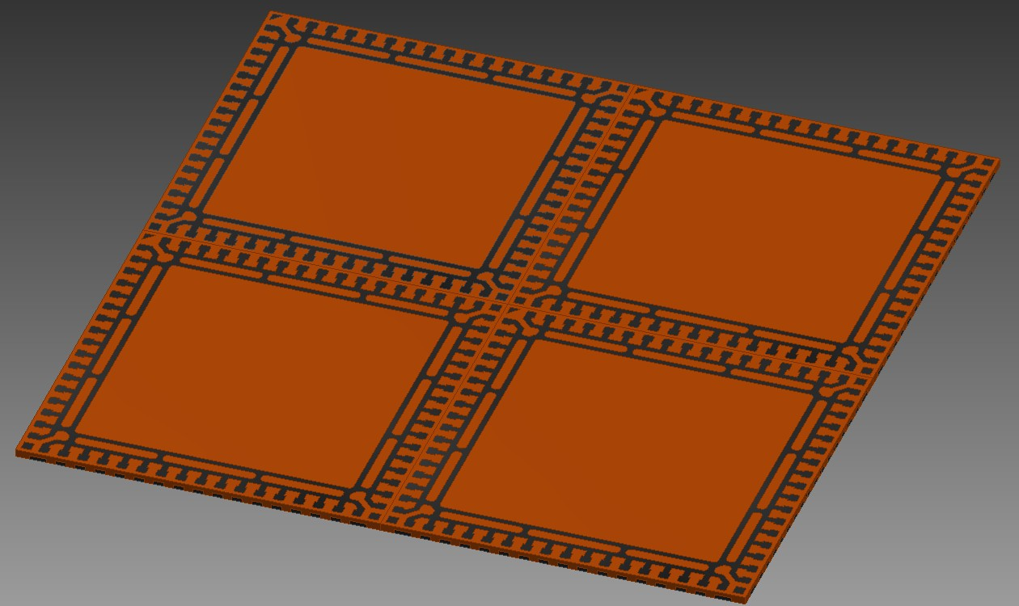
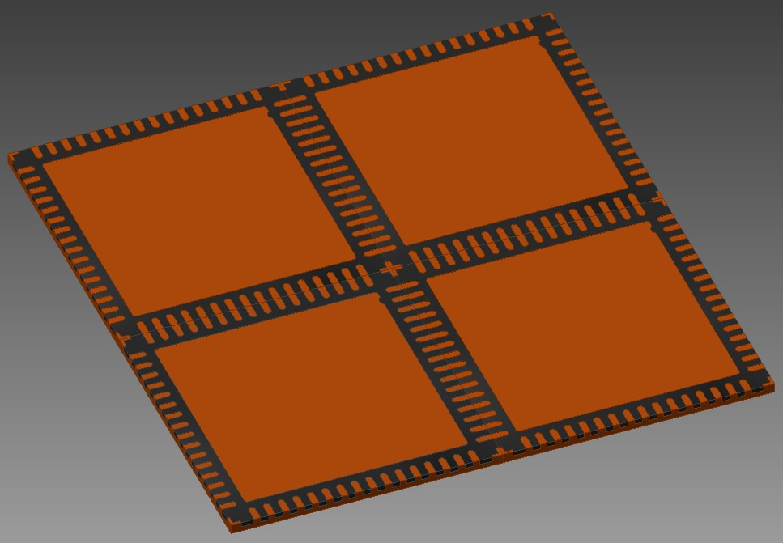
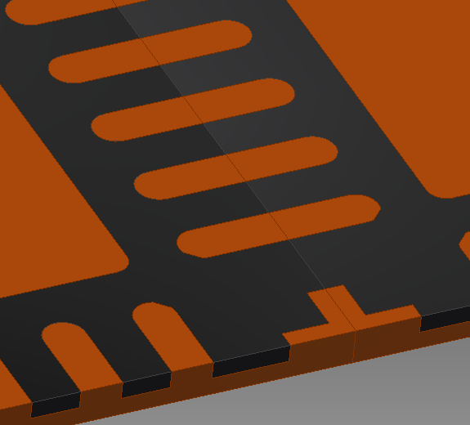
Molding (show 2x2 unit)
Top side view
Back side view

Slide 24
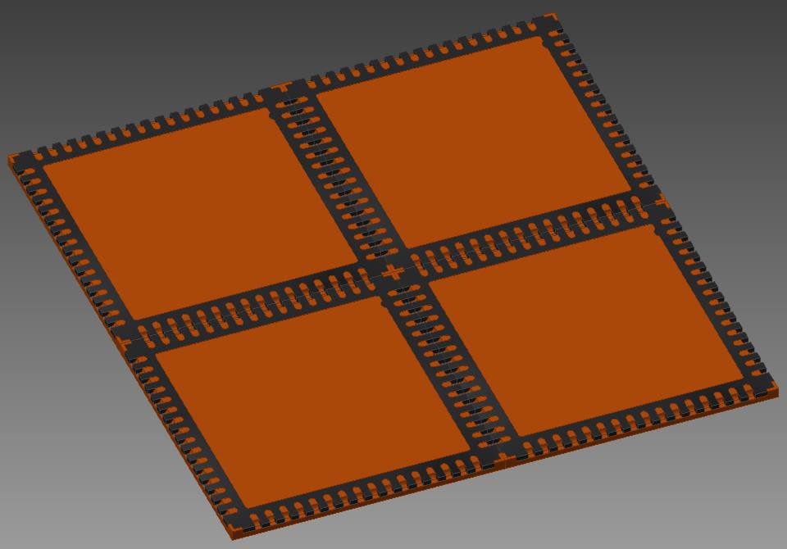
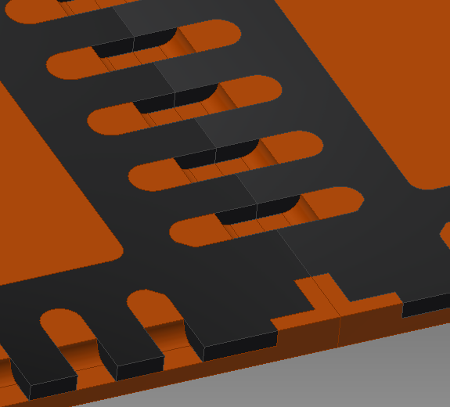
2nd etching(show 2x2 unit)
Top side view
Back side view

Slide 25
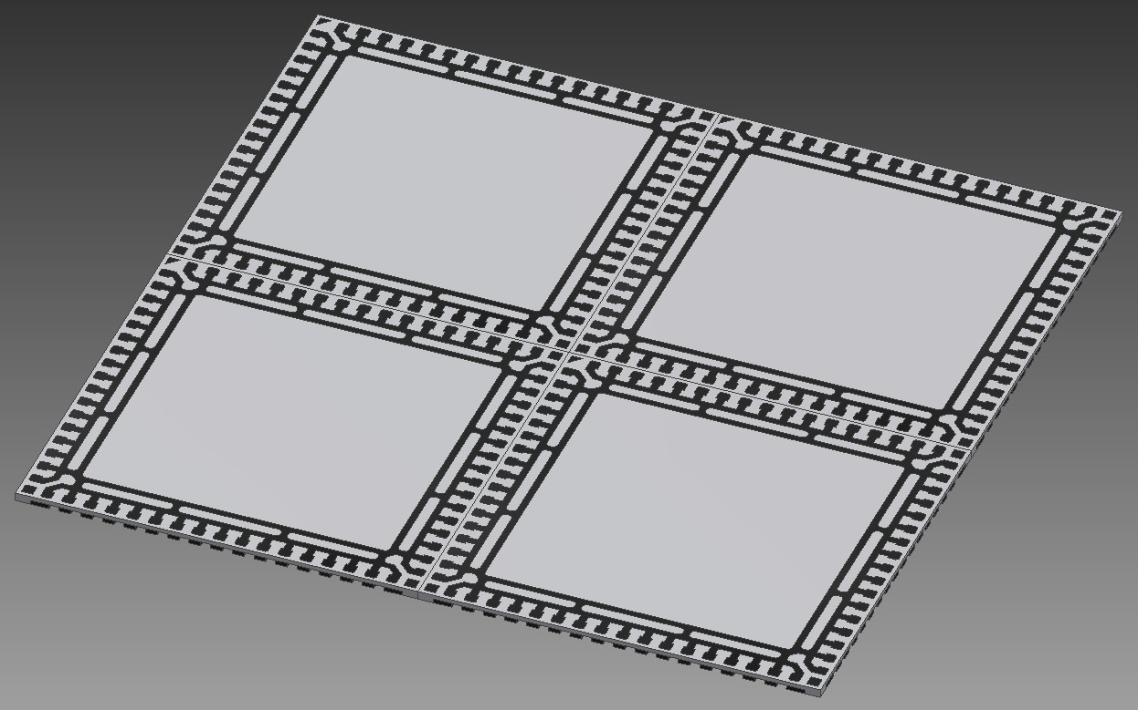
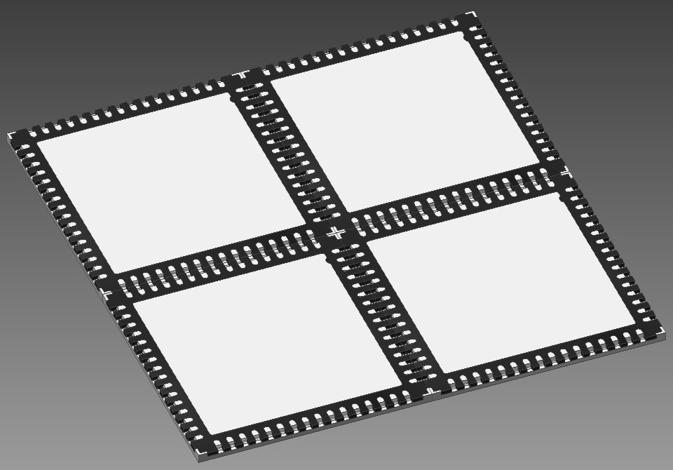
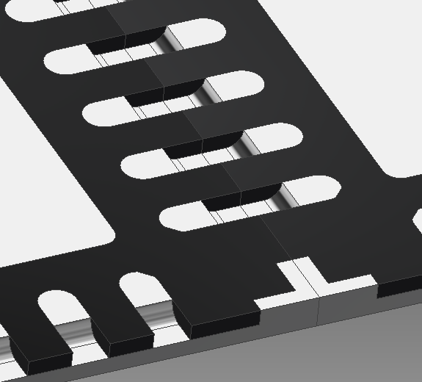
Plating (show 2x2 unit)
Top side view
Back side view

Slide 26
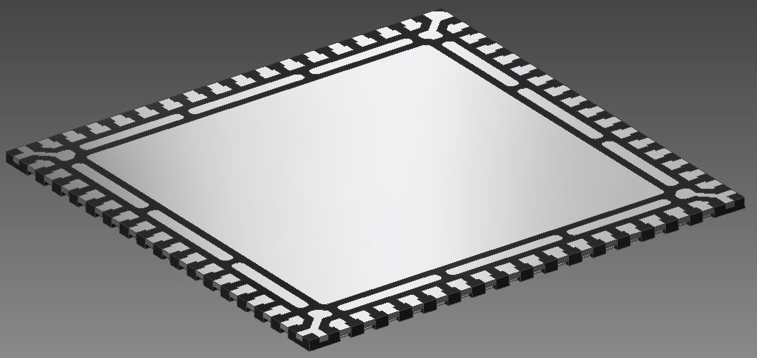
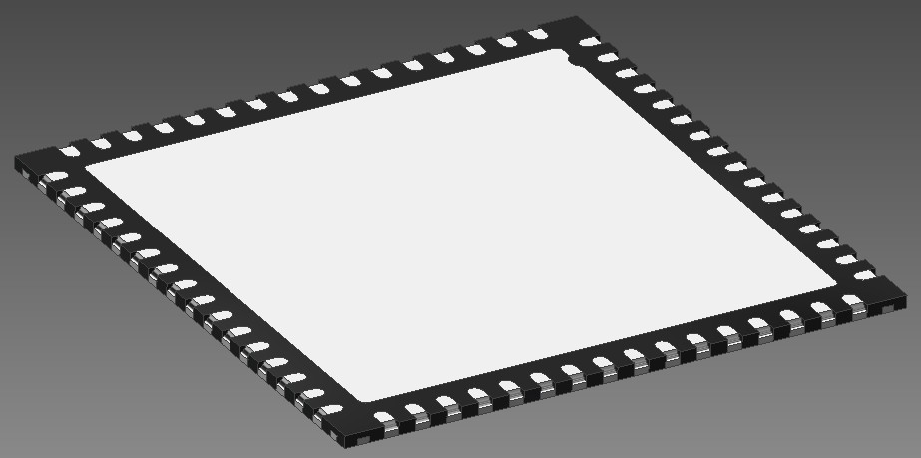
Sawing Show (Unit)
A
A
Top side view
Back side view
A-A section

Slide 27
D.營運績效

Slide 28
營運績效(合併月營收)
千元NTD

Slide 29
營運績效(合併季損益表)

Slide 30
營運績效(合併年損益表)

Slide 31
2015~2017年合併資產負債表摘要

Slide 32
產品組合(應用別)
*依銷售金額(US$)分類
IC：SOP、TSSOP、TSOP、QFP
Discrete：SOT

Slide 33
產品組合(製程別)
*依銷售金額(US$)分類

Slide 34
E.未來展望

Slide 35
展望與成長動能
擴充QFN產能
推廣Pre-Mold技術、開發Wettable Flank QFN基板
跨足其他應用之蝕刻元件
評估同業購併

Slide 36
Q & A

